Slide 1
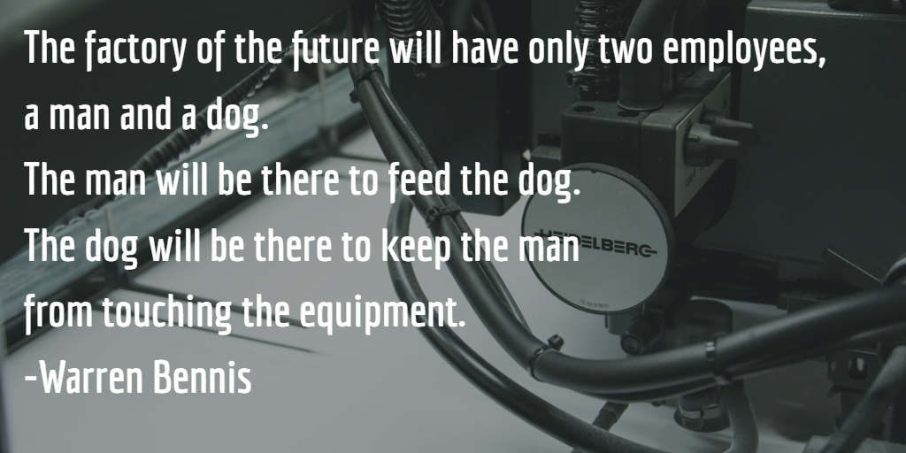
Automate for fun & profit Azure Webjobs & Functions
Santosh Hari

Slide 2

Azure MVP
Document DB Wizard
Dir of Tech: Spectrum Bridge
Consultant: Sand Dollar
ONETUG & Orlando Codecamp
Email: s.hari@sanddollartechnology.com
Twitter: @_s_hari

Slide 3
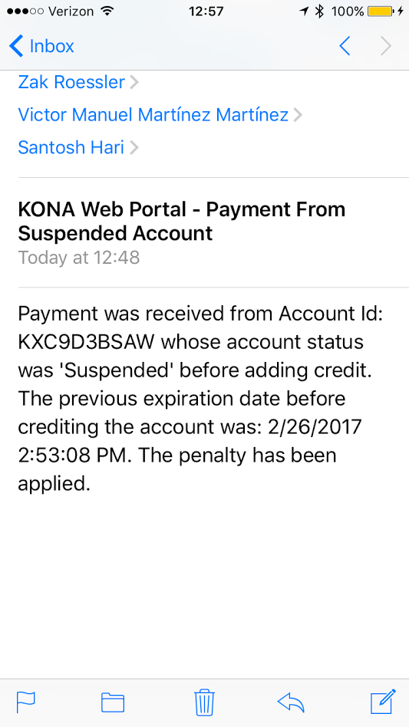
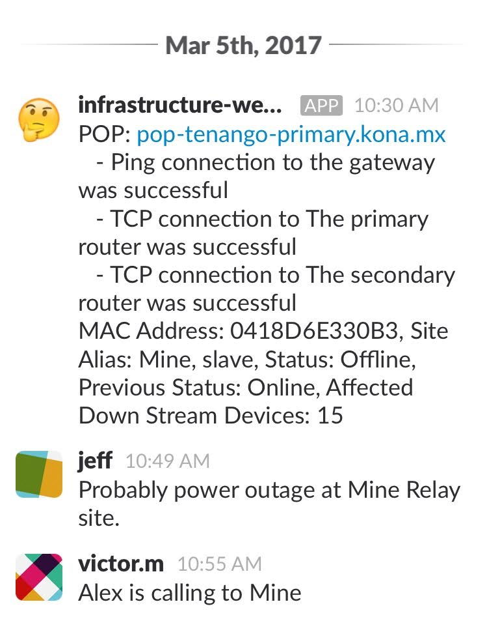

Slide 4
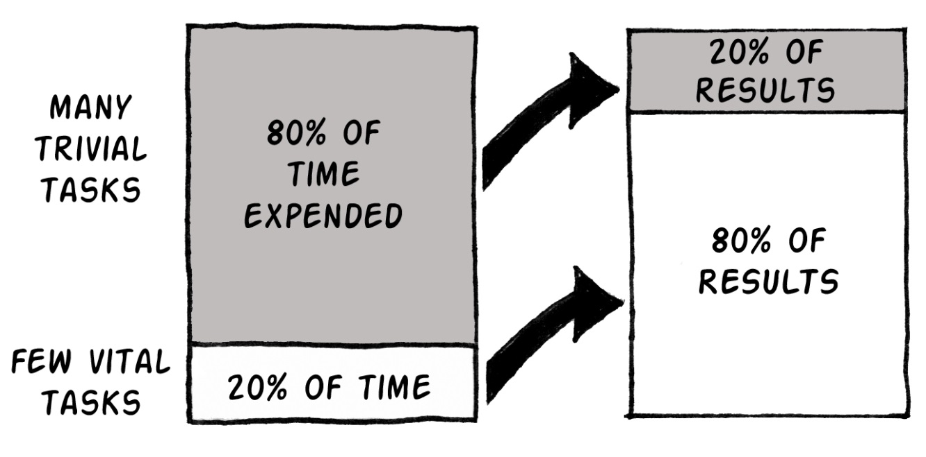
Philosophies
Automate
Integrate
Resilient
Reduce code
Know thyself
Pareto
Notes:
If it runs often, on a schedule or by multiple people
When possible integrate with existing services before building a new one
Make your product tolerant to error
Write code and then take a scalpel
Know your strengths and weaknesses
80-20

Slide 5
Poll time
How many people here:
Write code?
Write scripts?
.NET/NodeJS/Powershell?
Worked with Azure?
Written Console Applications?
Hosted a website on Azure?

Slide 6
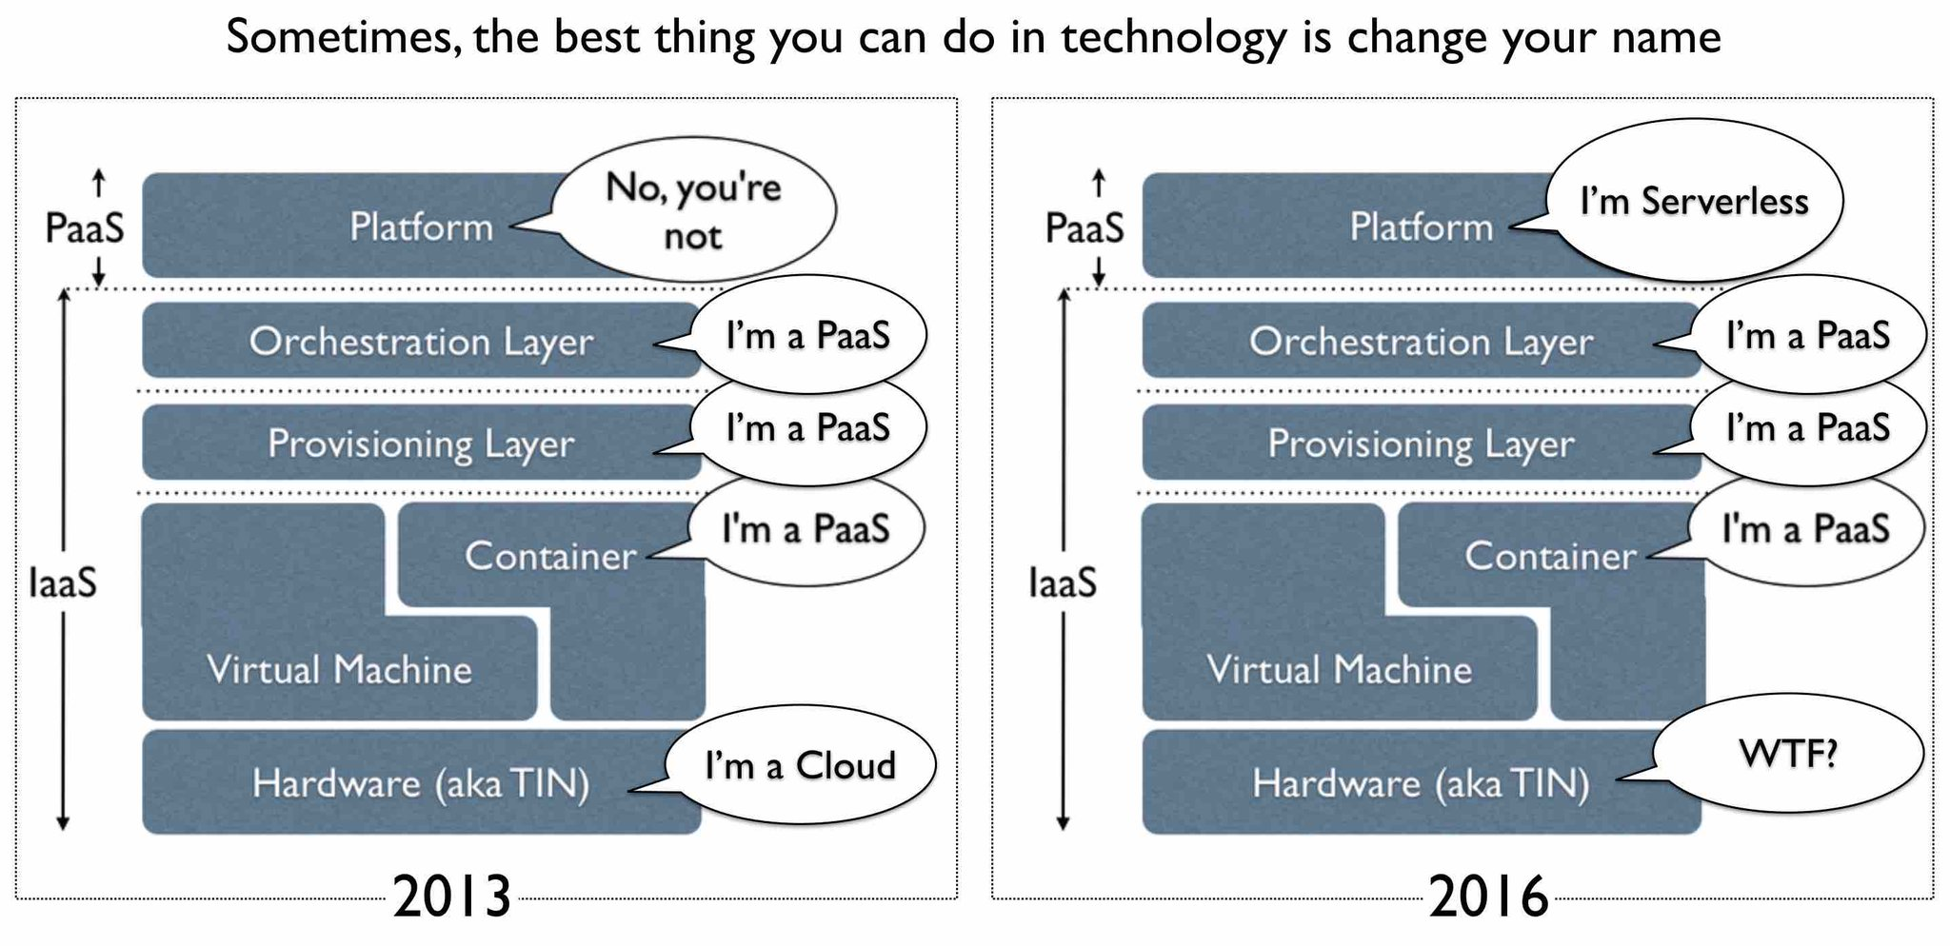
Nebulous Cloudy terms
*Image stolen from Twitter
Notes:
here's a lot of confusing terms in the Cloud space. And that's not counting the term "Cloud."
IaaS (Infrastructure as a Services) - Virtual Machines and stuff on demand.
PaaS (Platform as a Service) - You deploy your apps but try not to think about the Virtual Machines underneath. They exist, but we pretend they don't until forced. You still have to configure scaling
SaaS (Software as a Service) - Stuff like Office 365 and Gmail. You pay a subscription and you get email/whatever as a service. It Just Works.
"Serverless Computing" doesn't really mean there's no server. Serverless means there's no server you need to worry about. That might sound like PaaS, but it's higher level that than.
Serverless Computing is like this - Your code, a slider bar, and your credit card. You just have your function out there and it will scale as long as you can pay for it. It's as close to "cloudy" as The Cloud can get.

Slide 7
Jobs
Program, script or any compute task
Job Execution – regular and batch jobs in the background
Manual
Automatic
Scheduled
Triggered by events
Notes:
I want you to pay attention to these various methods of execution because I will walk through all of them today

Slide 8
What is automation?
Automatic execution of regular and batch jobs in the background
Notes:
This is the scope of what we will be covering today. Please keep in mind you can hear the term automation in various fields including devops. We’re only talking about automating the programs you created

Slide 9

History of Automation
Executables and Scripts
Older: .cmd, .bat, .exe (using windows cmd)
Newer: .ps1 (using powershell)
Run mechanism
Windows Service
Task Scheduler
SSIS
Powershell
Cron (Unix)
Physical or Virtual Machine
Notes:
We used to have only physical then we got VMs in the late 90s - early 00s
Strictly in the context of windows

Slide 10
Physical and Virtual Machines
Same Cons as dedicated hosting/IaaS
Maintenance
Deployment
Scaling
Multiple environments
Integrations
Notes:
Requires OS and software maintenance / upgrades aka sys admin
Deployment takes a while
Scaling is slower
Multiple deployment environments (production and staging) not available out-of-box
Integrations need configuration

Slide 11
Cloud job hosts - Webjobs & Functions
Advantages:
Cloud based
Developer friendly
Many Languages
Easy Integrations
Notes:
We can discuss Azure Functions and Azure App Service WebJobs together because they are both code-first integration services and designed for developers. They enable you to run a script or a piece of code in response to various events, such as new Storage Blobs or a WebHook request. Here are their similarities:
Both are built on Azure App Service and enjoy features such as source control, authentication, and monitoring.
Both are developer-focused services.
Both support standard scripting and programming languages.
Both have NuGet and NPM support.
Can work with the website or can work by themselves
Easy to integrate with other Azure & other 3rd party services

Slide 12
Tonight’s objectives
Write a console app and deploy as webjob (first manual, then scheduled)
Write an Azure webjob with SDK with almost zero code
Create an Azure Function with the browser
New VS tools
Thou shall use Queues
Notes:
Queue storage delivers asynchronous message queueing for communication between application components
Queue storage helps make your application scalable and less sensitive to individual component failure. If part of your architecture goes down, messages are buffered then naturally picked up by other message processing nodes, maintaining the integrity of your workload.
Applications absorb unexpected traffic bursts, preventing servers from being overwhelmed by a sudden flood of requests. And queue length can be monitored to add elasticity to your application, deploying or hibernating additional worker nodes based on customer demand.

Slide 13
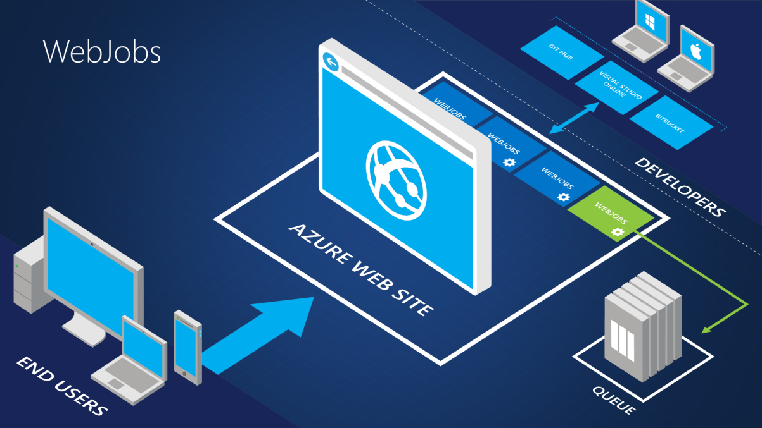
Webjobs
Program and scripts running on Azure App Service
.cmd, .bat, .exe (using windows cmd)
.ps1 (using powershell)
.sh (using bash)
.php (using php)
.py (using python)
.js (using node)
.jar (using java)
Notes:
Put simply, if you can run a program or script on your local machine, all you need to get it running on the cloud is upload it. It really is that easy! It will take less than 5 minutes from signing up on Azure to uploading and running your code. WebJobs is what you get when you cross a fully featured and managed cloud-based hosting platform with a generic compute environment. In other words, WebJobs is compute on a managed platform. Everything to make your code run, and keep it running is managed for you. All you have to do is put your program in a folder.

Slide 14
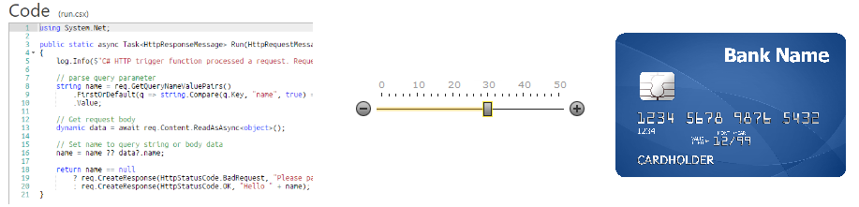
Functions
Next generation webjobs
Browser coding
Better integration
Pay-per-use
*Image copied from Scott Hanselman
Notes:
Functions is the natural evolution of WebJobs in that it takes the best things about WebJobs and improves upon them. The improvements include:
Streamlined dev, test, and run of code, directly in the browser.
Built-in integration with more Azure services and 3rd-party services like GitHub WebHooks.
Pay-per-use, no need to pay for an App Service plan.
Automatic, dynamic scaling.
For existing customers of App Service, running on App Service plan still possible (to take advantage of under-utilized resources).
Integration with Logic Apps.

Slide 15
 | Functions | Webjobs
Scaling | No Config | Host App Service
Pricing | Pay-per-use | Host App Service
Run type | Triggered, scheduled | Triggered, Scheduled, continuous
Triggers | Timer, DocDB, Event Hubs, Webhook, Mobile Apps, Notification Hub, Service Bus, Storage | Storage, Service Bus
Dev tools | In-browser, VS (preview) | VS (advanced)
Notes:
Whether to use Functions or WebJobs ultimately depends on what you're already doing with App Service. If you have an App Service app for which you want to run code snippets, and you want to manage them together in the same DevOps environment, you should use WebJobs. If you want to run code snippets for other Azure services or even 3rd-party apps, or if you want to manage your integration code snippets separately from your App Service apps, or if you want to call your code snippets from a Logic app, you should take advantage of all the improvements in Functions.

Slide 16
Coding: Recommendations
Azure account
Azure storage explorer
Visual Studio 2015
Only works with VS2015 Update 3
Azure 2.9.6 SDK https://go.microsoft.com/fwlink/?LinkId=518003&clcid=0x409
VS Tools for Azure Functions https://aka.ms/azfunctiontools

Slide 17
Code: Webjobs (Console)

Slide 18
Code: Webjobs (SDK)

Slide 19
Code: Functions (browser)

Slide 20
Code: Functions (Visual Studio)

Slide 21

Common Scenarios
Timer-based processing
Azure service event processing
SaaS event processing
Serverless web application architectures
Serverless mobile backends
Real-time stream processing
Real-time bot messaging
Your App or Service
Office 365
Office Graph
Azure Storage
Legacy Systems
Web Services
Other Functions
Notes:
Azure Functions are “event-driven” meaning they run based on associated and configure events, or “triggers”. For example an Azure Function could be triggered by a simple timer, such as running a process once every 24-hours, or triggered by an event in a document management system, such as when a new document is uploaded to a SharePoint library. Azure Functions can also respond to Azure-specific events, such as an image added to a Storage Blob or a notification arriving in a Message Queue.

Slide 22
Anatomy of a Function
A “Run” file that containing the function code
A “Function” file containing all service and trigger bindings and parameters
A “Project” file containing project assembly and NuGet package references
App Service settings, such as connection strings and API keys
code
Executable code
Function configuration
.NET Core and Project references
Notes:
An Azure Function is really a group of a few files that work in harmony. All actual function logic resides in a “Run” file written in a language of choice. A “Project” file is similar to a project file in other technologies such as .NET Core or Universal Windows Platform and contains “secondary” assembly references such as NuGet packages. Finally a “Function” file contains information about triggers and parameters, such as locations of Storage Queue connection strings and whether the parameter is design as an “in”, “out” or “bi-directional”. Optionally, additional configuration is also found in the Function App Settings such as an API Key or database connection string.

Slide 23
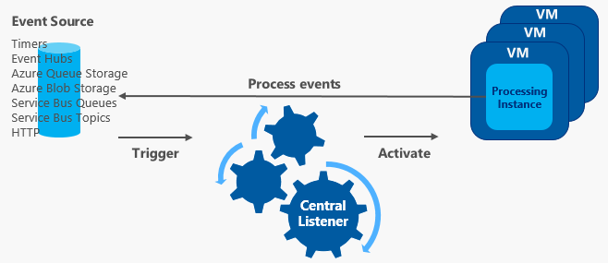
Functions - scaling
Notes:
Functions uses a central listener to evaluate compute needs based on the configured triggers and to decide when to scale out or scale in.
Listener continuously processes hints for memory requirements and trigger-specific data points.
For example, in the case of an Azure Queue Storage trigger, the data points include the queue length and queue time of the oldest entry.
COLD START PENALTY
When running on a Consumption plan, if a Function App has gone idle, there can be up to a 10-minute day in processing new blobs.
Once the Function App is running, blobs are processed more quickly.
To avoid this initial delay, either use a regular App Service Plan with Always On enabled or use another mechanism to trigger the blob processing, such as a queue message that contains the blob name.

Slide 24
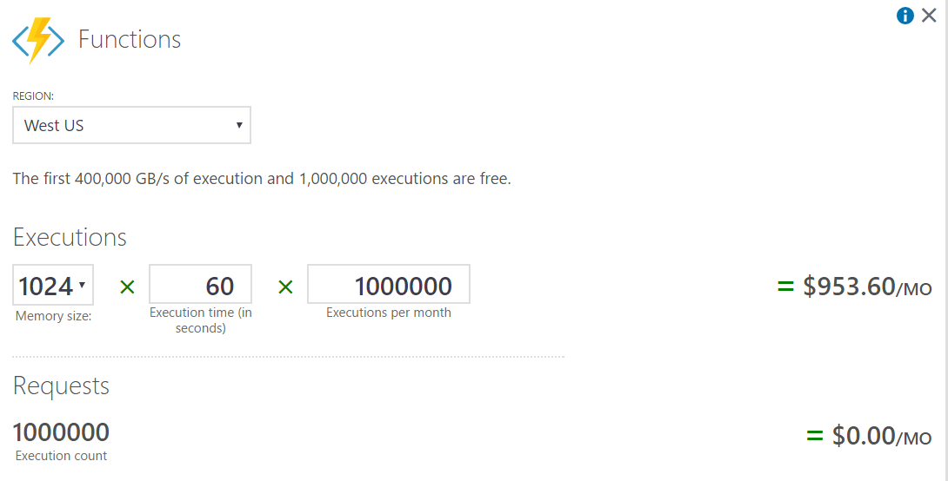
Function Cost - Consumption
Notes:
The Consumption plan automatically scales CPU and memory resources by adding additional processing instances based on the runtime requirements of the functions in a function app.
Every function app processing instance is allocated memory resources up to 1.5 GB.
Cold start penalty
Usage is reported per function app, only for time when code is being executed. The following are units for billing:
Resource consumption in GB-s (gigabyte-seconds) computed as a combination of memory size and execution time for all functions running in a Function App.
Executions counted each time a function is executed in response to an event, triggered by a binding.

Slide 25
Functions best practices
Avoid long running
Avoid direct function-to-function calls
Stateless + Idempotent
Code defensively
Async ok but avoid Task.Result
Notes:
Avoid large long running functions
Large long running functions can timeout. Particularly because of many Node.js dependencies imports
Refactor large functions into smaller function sets that work together and return fast responses.
Cross function communication.
When integrating multiple functions, it is generally a best practice to use storage queues for cross function communication.
Service Bus topics and Event hubs also useful
Write functions to be stateless
Functions should be stateless and idempotent if possible. Pass state in data. Repeated calls should produce same result
Write defensive functions.
Assume your function could encounter an exception at any time. Design your functions with the ability to continue from a previous fail point during the next execution.
Use async code but avoid Task.Result
Task.Result does a busy-wait on a lock of another thread. Holding a lock creates the potential for deadlocks.

Slide 26
Resources
Webjobs Resources https://docs.microsoft.com/en-us/azure/app-service-web/websites-webjobs-resources
Azure Functions Intro https://docs.microsoft.com/en-us/azure/azure-functions/functions-overview
Compare webjobs and functions https://docs.microsoft.com/en-us/azure/azure-functions/functions-compare-logic-apps-ms-flow-webjobs

